Slide 1

Report-14 Feb
Wisjul fighter

Slide 2

Content
Controller
PSO and result
Next Plan

Slide 3

Controller

Slide 4
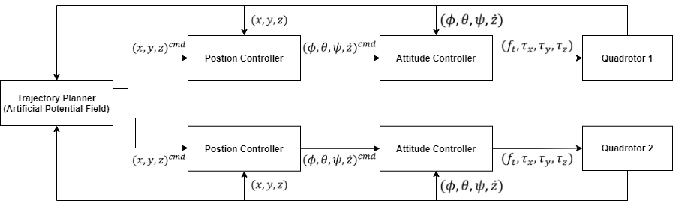
Diagram Block

Slide 5
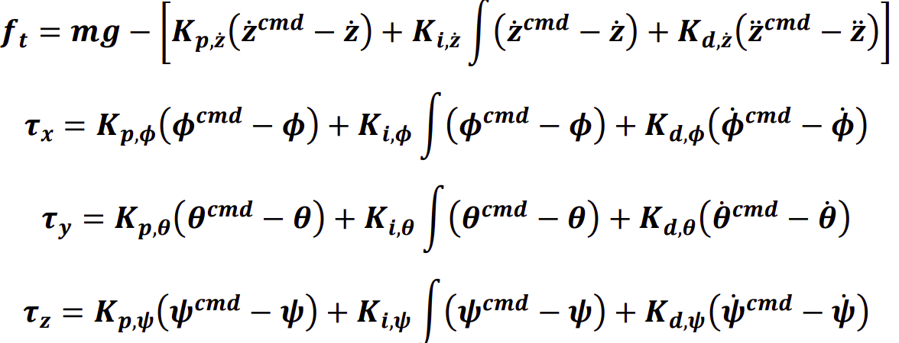
Equation – Attitude Controller

Slide 6
Equation – Position Controller
In Revision (Adding Yaw)

Slide 7
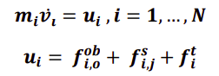
Equation – Trajectory Planner (1)

Slide 8
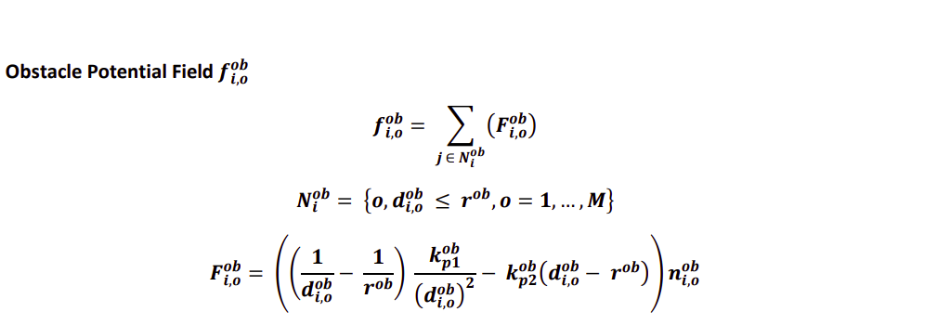
Equation – Trajectory Planner (2)

Slide 9
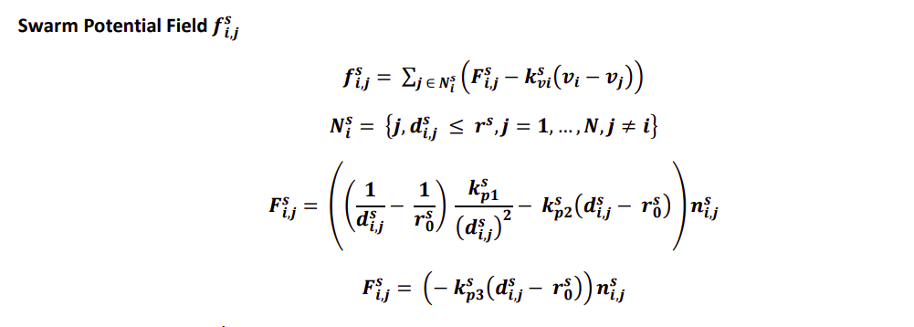
Equation – Trajectory Planner (3)

Slide 10
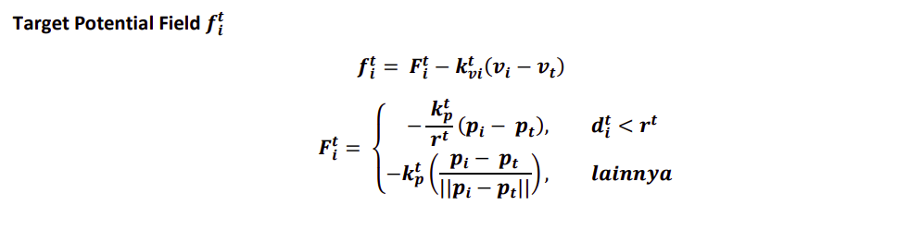
Equation – Trajectory Planner (4)

Slide 11

PSO

Slide 12
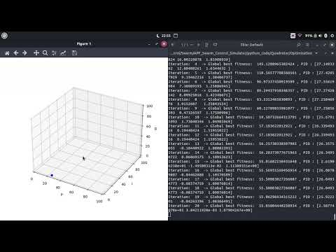
Animation

Slide 13

Result

Slide 14
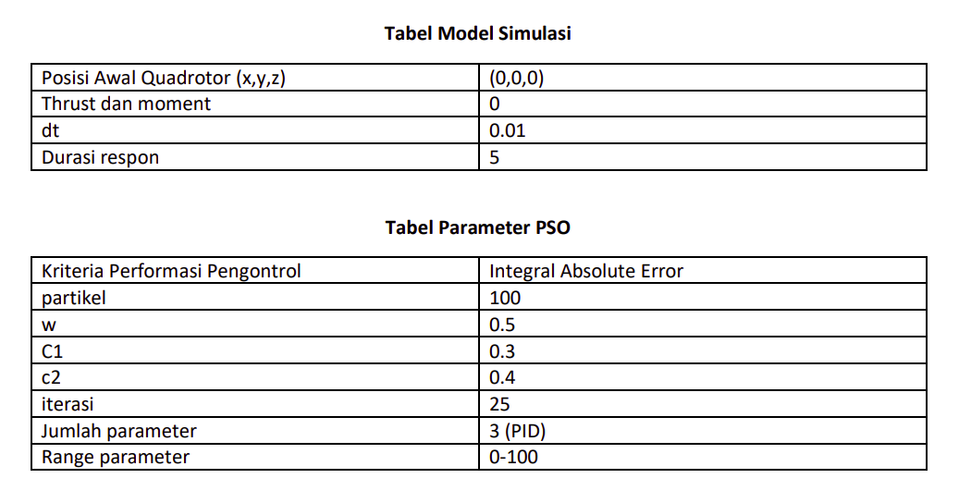
PSO

Slide 15
Constraint
Parameter Pengontrol PID (Kp, Ki, Kd) attitude lain = (0,0,0)

Slide 16
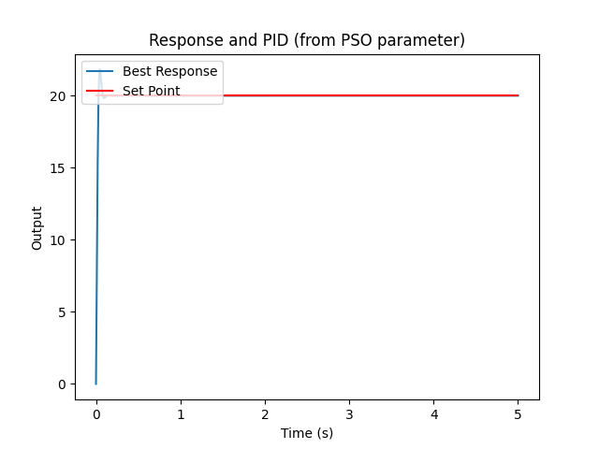
Setpoint phi 20 degree
Best fitness -> 42.749358873151905 Best parameter -> [0. 0. 0.88661492]

Slide 17
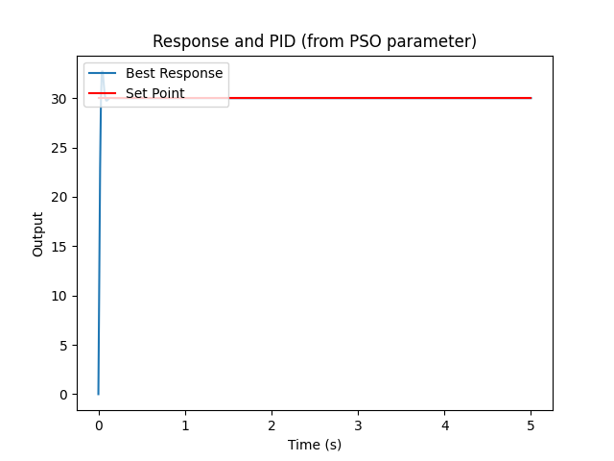
Setpoint phi 30 degree
Best fitness -> 64.10906872784162 Best parameter -> [0. 0. 0.88616771]

Slide 18

Setpoint theta 20 degree
Best fitness -> 42.739282592936405 Best parameter -> [0. 0. 0.88616339]

Slide 19
Setpoint theta 30 degree
Best fitness -> 64.10980225307378 Best parameter -> [0. 0. 0.8861349]

Slide 20

Setpoint psi 20 degree
Best fitness -> 42.7392362967512 Best parameter -> [0. 0. 0.88616098]

Slide 21

Setpoint psi 30 degree

Slide 22
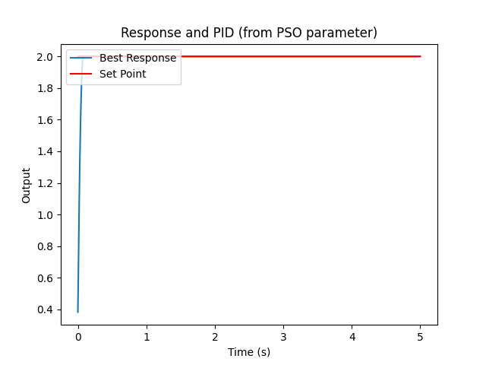
Setpoint zdot 2m/s
Best fitness -> 5.103908948419274 Best parameter -> [96.17007323 7.35729734 0. ]

Slide 23
Parameter yang berubah
Posisi awal = (0,0,5)
Pengontrol attitude menggunakan hasil PSO attitude yang di slide sebelumnya

Slide 24
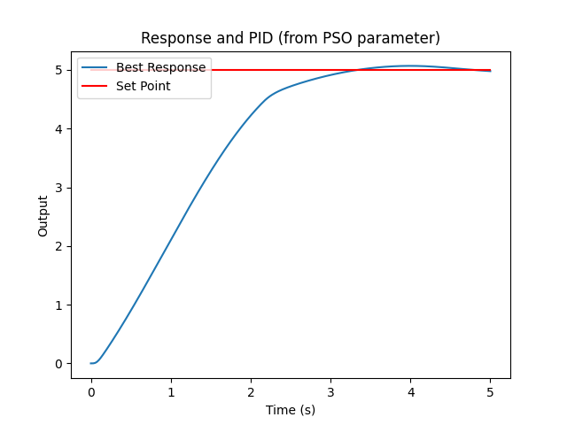
Setpoint x = 5m
Best fitness -> 626.2935904424725 Best parameter -> [27.83997997 70.32934802 4.70222228]

Slide 25
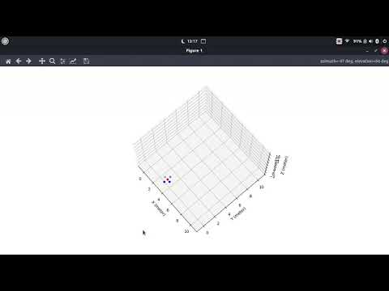
Setpoint x = 5m Animation

Slide 26
Setpoint y = 5m
Best fitness -> 626.293636693713 Best parameter -> [27.83997036 68.08563516 47.6545511 ]

Slide 27
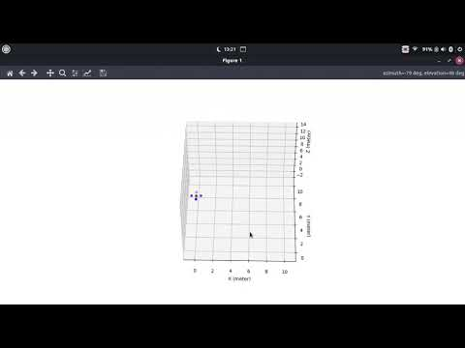
Setpoint y = 5m Animation

Slide 28
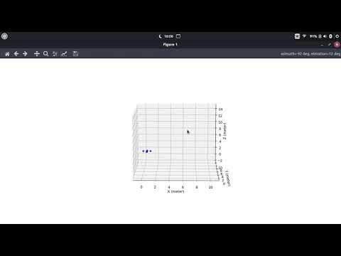
Setpoint (0.7, 2, 0) Animation

Slide 29
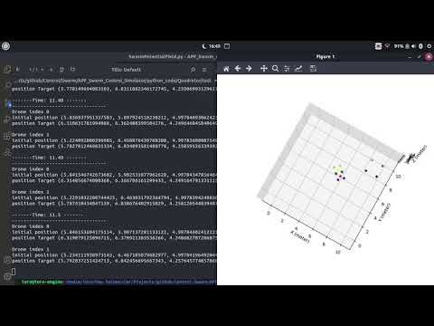
Testing Swarm Control (without obstacle but with target) the target = ship (4 black dots)

Slide 30

Next Plan

Slide 31
NEXT PLAN
Preparation for Implementation (check Tello)
Finish Position Controller with Yaw
Add obstacle in the simulation
Trying 3 Quadrotor in Simulation

